Slide 1
Introduction to Distance Vector Routing Protocols

Slide 2
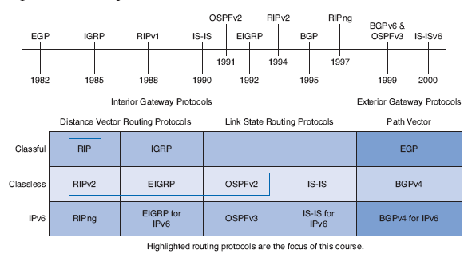
Introduction to Distance Vector Routing Protocols
Understanding the operation of distance vector routing is critical to enabling, verifying, and troubleshooting these protocols.
Notes:
There are advantages and disadvantages to using any type of routing protocol.
Some of their inherent pitfalls, and
Remedies to these pitfalls
Understanding the operation of distance vector routing is critical to enabling, verifying, and troubleshooting these protocols.

Slide 3
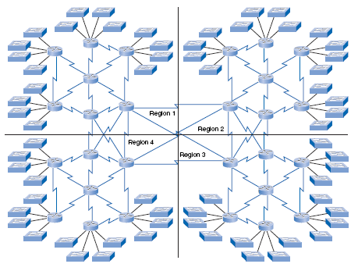
Configuring and maintaining static routes for a large network would be overwhelming.
What happens when that link goes down at 3:00 a.m.?
Notes:
Configuring and maintaining static routes for a large network would be overwhelming.
What happens when that link goes down at 3:00 a.m.?

Slide 4
Why did Cisco develop IGRP/EIGRP?
RIP: Routing Information Protocol originally specified in RFC 1058.
IGRP: Interior Gateway Routing Protocol - Cisco proprietary
EIGRP: Enhanced IGRP – Cisco proprietary
IGRP and EIGRP: Cisco never submitted RFCs to IETF for these protocols.
Notes:
RIP: Routing Information Protocol originally specified in RFC 1058.
Metric: Hop count
Hop count greater than 15 means network is unreachable.
Routing updates: Broadcast/multicast every 30 seconds
IGRP: Interior Gateway Routing Protocol - Cisco proprietary
Composite metric: Bandwidth, delay, reliability and load
Routing updates: Broadcast every 90 seconds
IGRP is the predecessor of EIGRP and is now obsolete
EIGRP: Enhanced IGRP – Cisco proprietary
It can perform unequal-cost load balancing.
It uses Diffusing Update Algorithm (DUAL) to calculate the shortest path.
No periodic updates, only when a change in topology.
IGRP and EIGRP: Cisco never submitted RFCs to IETF for these protocols.

Slide 5

Meaning of Distance Vector
Distance vector (repeat)
  Routes are advertised as vectors of distance and direction.
Direction is simply the:
  nexthop router or
  exit interface.
Routing protocol
  Does not know the topology of an internetwork.
  Only knows the routing information received from its neighbors.
Notes:
Distance vector (repeat)
Routes are advertised as vectors of distance and direction.
Distance is defined in terms of a metric
Such as hop count,
Direction is simply the:
nexthop router or
exit interface.
Routing protocol
Does not know the topology of an internetwork.
Only knows the routing information received from its neighbors.
Distance Vector routing protocol does not have the knowledge of the entire path to a destination network.

Slide 6
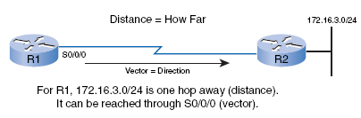
Meaning of Distance Vector
I can get to 172.16.3.0/24 in one hop out my S0/0/0.
What is the Distance to 172.16.3.0/24?
  1 hop
What is the Direction:
  S0/0/0
Does R1 have a topology map?
  No, it only knows distance and direction!
Notes:
R1 knows that:
Distance: to 172.16.3.0/24 is 1 hop
Direction: out interface S0/0/0 toward R2
Remember: R1 does not have a topology map, it only knows distance and direction!

Slide 7
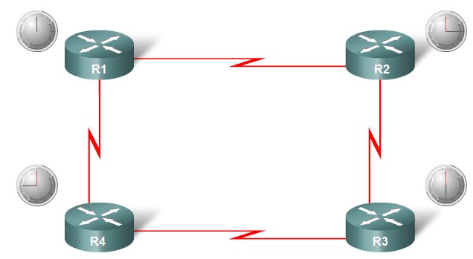
Operation of Distance Vector Routing Protocols
Timer Expires
Timer Expires
Timer Expires
Timer Expires
Periodic updates
Some distance vector routing protocols periodically broadcast the entire routing table to each of its neighbors. (RIP and IGRP)
  30 seconds for RIP
Inefficient:
  Bandwidth and CPU resources
  Always sent, even no changes
Notes:
Periodic updates
Some distance vector routing protocols periodically broadcast the entire routing table to each of its neighbors. (RIP and IGRP)
30 seconds for RIP
90 seconds for IGRP
Inefficient: updates consume bandwidth and router CPU resources
Periodic updates always sent, even no changes for weeks, months,…

Slide 8
Operation of Distance Vector Routing Protocols
Neighbor of R1
R1 is unaware of R3 and its networks
Neighbor of R1
What are Neighbors?
Neighbors are routers that:
  Share a link
  Use the same routing protocol.
What are the only addresses routers know about before there is any routing knowledge?
  Network addresses of its own interfaces
  Network addresses of its neighbors.
Notes:
Neighbors are:
routers that share a link
use the same routing protocol.
Router is only aware:
Network addresses of its own interfaces
Network addresses of its neighbors.
It has no broader knowledge of the network topology.

Slide 9
Operation of Distance Vector Routing Protocols
Timer Expires
Routing Protocols use
  Broadcast updates (255.255.255.255)
  Multicast updates
Neighbor routers will process the updates.
What will other devices on that link do if they receive a routing update but are not running that routing protocol including hosts?
  They will process the update up to Layer 3 (Multicast update) or Layer 4 (Broadcast update) before discarding it.
Notes:
Broadcast updates (Destination IP 255.255.255.255)
Some protocols use multicasts (later)
Updates are entire routing tables with some exceptions (later)
Neighboring routers that are configured with the same routing protocol will process the updates.
Other devices such as host computers will also process the update up to Layer 3 before discarding it.

Slide 10
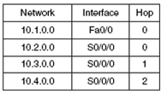
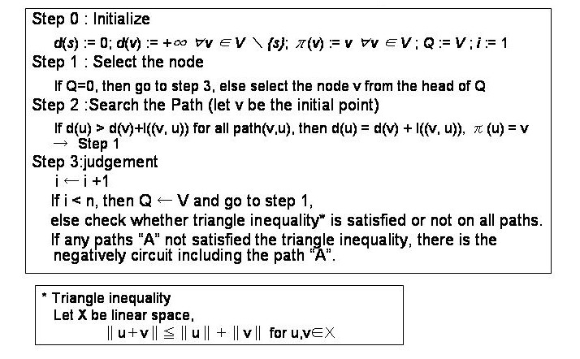
Routing Protocol Algorithms
The routing protocol algorithm used by a particular routing protocol is responsible for building and maintaining the router’s routing table.
Notes:
The algorithm used by a particular routing protocol is responsible for building and maintaining the router’s routing table.
The algorithm used for the routing protocols defines the following processes:
Mechanism for sending and receiving routing information
Mechanism for calculating the best paths and installing routes in the routing table
Mechanism for detecting and reacting to topology changes

Slide 11
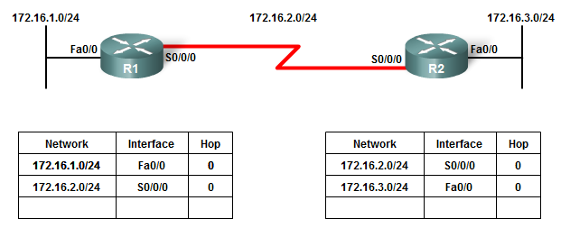
Routing Protocol Algorithms
Update
Update
The algorithm sends and receives updates.
Notes:
R1 and R2 are configured with RIP.
The algorithm sends and receives updates.
Both R1 and R2 then glean new information from the update.

Slide 12
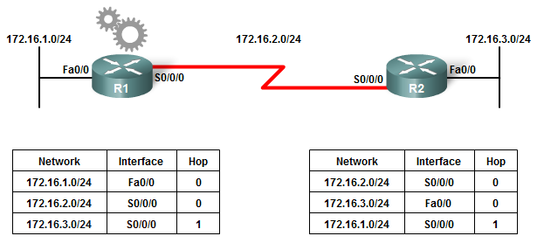

Routing Protocol Algorithms
Calculating best paths and installing new routes
Update
Update
The algorithm on each router:
  Independently makes calculations updates its routing table
Notes:
Each router learns about a new network.
The algorithm on each router:
makes its calculations independently
updates its routing table with the new information.

Slide 13
Routing Protocol Algorithms
Detecting and reacting to topology change
X
Update
The algorithm on each router:
  Detect and react to topology changes.
Notes:
Topology change.
LAN on R2 goes down
Algorithm constructs a “triggered” update and sends it to R1.
R1 removes network from the routing table.
Triggered updates - later

Slide 14
Routing Protocol Characteristics
More later
Time to convergence:
  Faster the better.
Scalability:
  How large a network the routing protocol can handle.
Classless (use of VLSM) or classful:
  Support VLSM and CIDR
Resource usage:
  Routing protocol usage of RAM, CPU utilization, and link bandwidth utilization.
Implementation and maintenance:
  Level of knowledge that is required for a network administrator.
Notes:
Other ways to compare routing protocols:
Time to convergence:
Faster the better.
Scalability:
How large a network the routing protocol can handle.
Classless (use of VLSM) or classful:
Support VLSM and CIDR
Resource usage:
Routing protocol usage of RAM, CPU utilization, and link bandwidth utilization.
Implementation and maintenance:
Level of knowledge that is required for a network administrator.

Slide 15
Advantages and Disadvantages of Distance Vector Routing Protocols
Advantages:
  Simplicity
  Low resource requirements
  Minimum link bandwidth
Disadvantages:
  Slow convergence
  Limited scalability
  Potential for routing loops (coming)

Slide 16
Network Discovery
Cold Start
Initial Exchange of Routing Information
Exchange of Routing Information

Slide 17
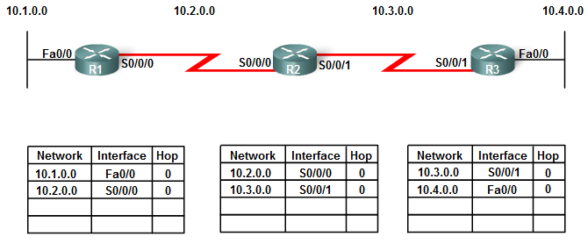
Cold Start
Network discovery is part of the process of the routing protocol algorithm that enables routers to first learn about remote networks.
Note: Complete routing tables are sent with the exception of any routes affected by split horizon (later).
First: Only knows directly connected networks.
Notes:
Network discovery is part of the process of the routing protocol algorithm that enables routers to first learn about remote networks.
Router powers up:
Knows nothing about the network topology
Does not know that there are devices on the other end of its links.
Knows only information saved in NVRAM (startup-config).

Slide 18
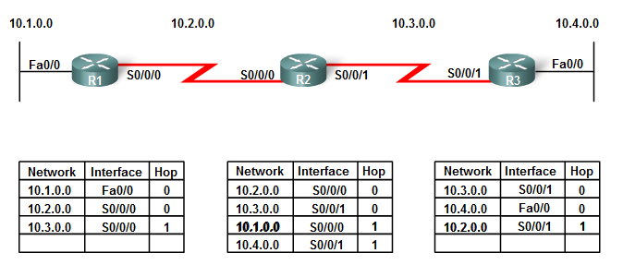
Initial Exchange of Routing Information
10.1.0.0 Update
10.1.0.0 Update
R1: (Sends complete routing table. 10.2.0.0 not sent because of split horizon - later)
  Sends an update about network 10.1.0.0 out the Serial 0/0/0 interface with a metric of 1
  Sends an update about network 10.2.0.0 out the FastEthernet 0/0 interface with a metric of 1
R2
  Receives an update from R1 about network 10.1.0.0 on Serial 0/0/0 with a metric of 1
  Stores network 10.1.0.0 in the routing table with a metric of 1
Notes:
R1:
Sends an update about network 10.1.0.0 out the Serial 0/0/0 interface with a metric of 1
Sends an update about network 10.2.0.0 out the FastEthernet 0/0 interface with a metric of 1
Receives an update from R2 about network 10.3.0.0 on Serial 0/0/0 with a metric of 1
Stores network 10.3.0.0 in the routing table with a metric of 1

Slide 19
Initial Exchange of Routing Information
10.2.0.0 Update
10.3.0.0 Update
R2 (At the same time as R1’s update):
  Sends an update about network 10.3.0.0 out the Serial 0/0/0 interface with a metric of 1
  Sends an update about network 10.2.0.0 out the Serial 0/0/1 interface with a metric of 1
R1
  Receives an update from R2 about network 10.3.0.0 on Serial 0/0/0 with a metric of 1
  Stores network 10.3.0.0 in the routing table with a metric of 1
R3
  Receives an update from R2 about network 10.2.0.0 on Serial 0/0/1 with a metric of 1
  Stores network 10.2.0.0 in the routing table with a metric of 1
Notes:
R2:
Sends an update about network 10.3.0.0 out the Serial 0/0/0 interface with a metric of 1
Sends an update about network 10.2.0.0 out the Serial 0/0/1 interface with a metric of 1
Receives an update from R1 about network 10.1.0.0 on Serial 0/0/0 with a metric of 1
Stores network 10.1.0.0 in the routing table with a metric of 1
Receives an update from R3 about network 10.4.0.0 on Serial 0/0/1 with a metric of 1
Stores network 10.4.0.0 in the routing table with a metric of 1

Slide 20
Initial Exchange of Routing Information
10.4.0.0 Update
10.4.0.0 Update
R3: (Same time as R1 and R2)
  Sends an update about network 10.4.0.0 out the Serial 0/0/1 interface with a metric of 1
  Sends an update about network 10.3.0.0 out the FastEthernet 0/0 interface with a metric of 1
R2
  Receives an update from R3 about network 10.4.0.0 on Serial 0/0/1 with a metric of 1
  Stores network 10.4.0.0 in the routing table with a metric of 1
Notes:
R3:
Sends an update about network 10.4.0.0 out the Serial 0/0/1 interface with a metric of 1
Sends an update about network 10.3.0.0 out the FastEthernet 0/0 interface with a metric of 1
Receives an update from R2 about network 10.2.0.0 on Serial 0/0/1 with a metric of 1
Stores network 10.2.0.0 in the routing table with a metric of 1

Slide 21
Initial Exchange of Routing Information
Have we reached convergence?
  No
What needs to still be learned?
  R1 does not have knowledge of 10.4.0.0
  R3 does not have knowledge of 10.1.0.0
Notes:
First round of update exchanges, each router knows about the connected networks of its directly connected neighbors.
R1 does not yet know about 10.4.0.0
R3 does not yet know about 10.1.0.0.
Full knowledge and a converged network will not take place until there is another exchange of routing information.

Slide 22
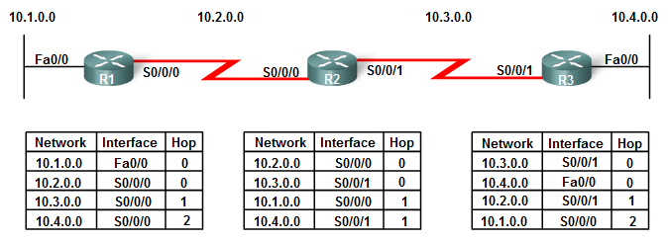
Next Exchange of Routing Information
Thanks, but nothing new
Update
Update
R1:
  Sends out complete routing table.
Does R2 learn anything new?
  No
Notes:
R1:
Sends an update about network 10.1.0.0 out the Serial 0/0/0 interface with a metric of 1.
Sends an update about networks 10.2.0.0 with a metric of 1 and 10.3.0.0 with a metric of 2 out the FastEthernet 0/0 interface.
Receives an update from R2 about network 10.4.0.0 on Serial 0/0/0 with a metric of 2 (new).
Stores network 10.4.0.0 in the routing table with a metric of 2.
Same update from R2 contains information about network 10.3.0.0 on Serial 0/0/0 with a metric of 1. There is no change; therefore, the routing information remains the same.

Slide 23
Next Exchange of Routing Information
Update
Update
S0/0/1
R2:
  Sends out complete routing table.
Does R1 Learn anything new?
  Yes, 10.4.0.0
Does R3 Learn anything new?
  Yes, 10.1.0.0
Notes:
R2:
Sends an update about networks 10.3.0.0 with a metric of 1 and 10.4.0.0 with a metric of 2 out the Serial 0/0/0 interface (new).
Sends an update about networks 10.1.0.0 with a metric of 2 (new) and 10.2.0.0 with a metric of 1 out the Serial 0/0/1 interface.
Receives an update from R1 about network 10.1.0.0 on Serial 0/0/0. There is no change; therefore, the routing information remains the same.
Receives an update from R3 about network 10.4.0.0 on Serial 0/0/1. There is no change; therefore, the routing information remains the same.

Slide 24
Next Exchange of Routing Information
Update
Update
S0/0/1
R3:
  Sends out complete routing table.
Does R2 learn anything new?
  No
Notes:
R3:
Sends an update about network 10.4.0.0 out the Serial0/0/1 interface.
Sends an update about networks 10.2.0.0 with a metric of 2 and 10.3.0.0 with a metric of 1 out the FastEthernet 0/0 interface.
Receives an update from R2 about network 10.1.0.0 on Serial 0/0/1 with a metric of 2 (new).
Stores network 10.1.0.0 in the routing table with a metric of 2.
Same update from R2 contains information about network 10.2.0.0 on Serial 0/0/1 with a metric of 1. There is no change; therefore, the routing information remains the same.

Slide 25
Note on Split Horizon
X
10.1.0.0 Update
10.1.0.0 Update
10.1.0.0 Update
S0/0/1
Distance vector routing protocols typically implement a technique known as split horizon.
  Prevents information from being sent out the same interface from which it was received.
More later
Notes:
Distance vector routing protocols typically implement a technique known as split horizon.
Prevents information from being sent out the same interface from which it was received.
For example, R2 would not send an update out Serial 0/0/0 containing the network 10.1.0.0 because R2 learned about that network through Serial 0/0/0.
More later

Slide 26
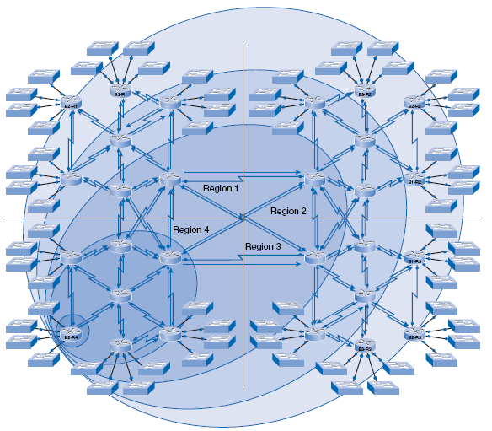
Convergence
5
The amount of time it takes for a network to converge is directly proportional to the size of that network.
Routing protocols are compared based on how fast they can propagate this information—their speed to convergence.
4
3
2
1
Notes:
The amount of time it takes for a network to converge is directly proportional to the size of that network.
It takes five rounds of periodic update intervals before most of the branch routers in regions 1, 2, and 3 learn about the new routes advertised by B2-R4.
Routing protocols are compared based on how fast they can propagate this information—their speed to convergence.
The speed of achieving convergence consists of
How quickly the routers propagate a change in the topology in a routing update to their neighbors
The speed of calculating best-path routes using the new routing information collected
A network is not completely operable until it has converged.
Therefore, network administrators prefer routing protocols with shorter convergence times.

Slide 27
Routing Table Maintenance
Periodic Updates
Bounded Updates
Triggered Updates
Random Jitter

Slide 28
Periodic Updates
Periodic Update
Periodic Update
Periodic Update
Periodic Update
Periodic Update
Periodic Update
S0/0/1
Depending on the routing protocol, routers must maintain the routing tables so that they have the most current routing information.
Some distance vector routing protocols use periodic updates.
  RIP and IGRP
Sent even when there is no new information.
Notes:
Some distance vector routing protocols use periodic updates with their neighbors and to maintain up-to-date routing information in the routing table.
RIPv1 and RIPv2
IGRP
Sent even when there is no new information.
The term periodic updates refers to the fact that a router sends the complete routing table to its neighbors at a predefined interval.

Slide 29
Periodic Updates
Periodic Updates
Periodic Update
Periodic Update
Periodic Update
Periodic Update
Periodic Update
Periodic Update
S0/0/1
Routing update may contain a topology change.
What might those changes be?:
  Failure of a link
  Introduction of a new link
  Failure of a router
  Change of link parameters
Notes:
This 30-second interval is a route update timer that also aids in tracking the age of routing information in the routing table.
Refreshed each time an update is received.
Routing update may contain a topology change.
Changes might occur for several reasons, including:
Failure of a link
Introduction of a new link
Failure of a router
Change of link parameters

Slide 30

RIP Timers
No update for 10.4.0.0 from R3 received, mark route as “possibly down”, but leave in routing table.
Still no update for 10.4.0.0 from R3 received. Remove this route from the routing table.
Periodic Update
Periodic Update
S0/0/1
IOS implements three additional timers for RIP.
Update timer: 30 seconds.
Invalid Timer: If an update has not been received in 180 seconds (the default), the route is marked as invalid by setting the metric to 16.
  Route still is in routing table.
Flush Timer: 240 seconds (default)
  When the flush timer expires, the route is removed from the routing table.
Hold-down Timer: 180 seconds (default)
  Later in this chapter.
Notes:
Update timer: Networks in routing table sent every 30 seconds.
IOS implements three additional timers for RIP.
Invalid Timer: If an update has not been received in 180 seconds (the default), the route is marked as invalid by setting the metric to 16.
Route still is in routing table.
Flush Timer: 240 seconds (default)
When the flush timer expires, the route is removed from the routing table.
Hold-down Timer: Helps stabilizes routing information and helps prevent routing loops during periods when the topology is converging on new information.
When a route is marked as unreachable, it must stay in hold-down long enough for all routers in the topology to learn about the unreachable network.
180 seconds (default)
The hold-down timer is discussed in more detail later in this chapter.

Slide 31
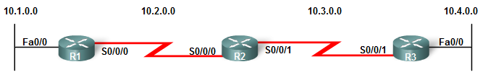
RIP Timers
Elapsed time since the last update, expressed in seconds
R1# show ip route
10.0.0.0/16 is subnetted, 4 subnets
C 10.2.0.0 is directly connected, Serial0/0/0
R 10.3.0.0 [120/1] via 10.2.0.2, 00:00:04, Serial0/0/0
C 10.1.0.0 is directly connected, FastEthernet0/0
R 10.4.0.0 [120/2] via 10.2.0.2, 00:00:04, Serial0/0/0
R1# show ip protocols
Routing Protocol is “rip”
Sending updates every 30 seconds, next due in 13 seconds
Invalid after 180 seconds, hold down 180, flushed after 240
<output omitted>
Routing Information Sources:
Gateway Distance Last Update
10.3.0.1 120 00:00:27
RIP timer values can be verified with two commands: show ip route and show ip protocols.
Notes:
RIP timer values can be verified with two commands: show ip route and show ip protocols.

Slide 32
Triggered Updates
Update timer not yet expired
X
Triggered Update
A triggered update is a routing table update that is sent immediately in response to a routing change.
Triggered updates do not wait for update timers to expire.
What is the advantage to a triggered update?
  Speeds up convergence.
Notes:
A triggered update is a routing table update that is sent immediately in response to a routing change.
Triggered updates do not wait for update timers to expire.
The detecting router immediately sends an update message to adjacent routers.
The receiving routers, in turn, generate triggered updates that notify their neighbors of the change.
Speeds up convergence.
Triggered updates are sent when one of the following events occurs:
An interface changes state (up or down).
A route has entered (or exited) the unreachable state.
A route is installed in the routing table.
No guarantee that the wave of updates would reach every appropriate router immediately.
There are two problems with triggered updates:
1. Packets containing the update message can be dropped.
2. Packets containing the update message can be corrupted by some link in the network.

Slide 33

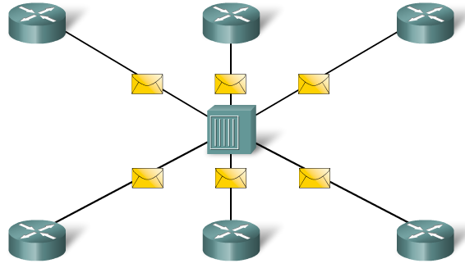
Random Jitter
Collision!
We will randomize our updates between 25.5 and 30 seconds so collisions don’t happen.
To prevent the synchronization of updates between routers, Cisco IOS uses a random variable, called RIP_JITTER, which subtracts a variable amount of time to the update interval for each router in the network.
  Ranges from 0 to 15 percent of the specified update interval.
  25.5 to 30 seconds for the default 30-second interval.
Notes:
When multiple routers transmit routing updates at the same time on multiaccess LAN segments, the update packets can collide and cause delays or consume too much bandwidth.
Note: Collisions are an issue only with hubs and not with switches.
Sending updates at the same time is known as the synchronization of updates.
To prevent the synchronization of updates between routers, Cisco IOS uses a random variable, called RIP_JITTER, which subtracts a variable amount of time to the update interval for each router in the network.
Ranges from 0 to 15 percent of the specified update interval.
25.5 to 30 seconds for the default 30-second interval.

Slide 34
Routing Loops
Defining a Routing Loop
Implications of Routing Loops
Count-to-Infinity Condition
Preventing Routing Loops by setting a Maximum Metric Value
Preventing Routing Loops with Hold-down Timers
Preventing Routing Loops with the Split Horizon Rule
Preventing Routing Loops with IP and TTL

Slide 35

Defining a Routing Loop
A routing loop is a condition in which a packet is continuously transmitted within a series of routers without ever reaching its intended destination network.
  Can occur when two or more routers have inaccurate routing information to a destination network.
  Issue with distance vector routing protocols but not link-state.
The loop can be a result of:
  Incorrectly configured static routes
  Incorrectly configured route redistribution (CCNP-level courses)
  Inaccurate routing because of slow convergence in a changing network
Notes:
A routing loop is a condition in which a packet is continuously transmitted within a series of routers without ever reaching its intended destination network.
Can occur when two or more routers have inaccurate routing information to a destination network.
The loop can be a result of:
Incorrectly configured static routes
Incorrectly configured route redistribution (redistribution is a process of handing the routing information from one routing protocol to another routing protocol and is discussed in CCNP-level courses)
Inconsistent routing tables not being updated because of slow convergence in a changing network

Slide 36

Implications of Routing Loops
A routing loop can have a devastating effect on a network.
What might a some problems with a routing loop?
A routing loop can create the following conditions:
  Link bandwidth – looping traffic
  Router’s CPU - Burdened with useless packet forwarding
  Routing updates might get lost or not processed in time.
  Packets might get lost in “black holes”.
Notes:
A routing loop can have a devastating effect on a network, resulting in degraded network performance or even network downtime.
A routing loop can create the following conditions:
Link bandwidth will be used for traffic looping back and forth between the routers
A router’s CPU will be burdened with useless packet forwarding
Routing updates might get lost or not be processed in a timely manner, making the situation even worse.
Packets might get lost in “black holes,” never reaching their intended destinations.

Slide 37
Implications of Routing Loops
This is great, I now have a route to 10.4.0.0 again!
IP Packet: DA 10.4.1.1
Loop until TTL is 0
X
Periodic Update 10.4.0.0 2 hops thru me
10.4.0.0 S0/0/1 2
S0/0/1
Assuming no split horizon, what if 10.4.0.0 network goes down?
Is there a potential for a problem here?
Notes:
1. 10.4.0.0 goes down.
2. R2 sent R3 a route to 10.4.0.0 before R3 could inform R2 that the network is down.
3. R3 installs the new route for 10.4.0.0 (bad information), pointing to R2 as the vector with a distance of 2.
R2 and R3 now believe that the other router is the next hop for traffic to 10.4.0.0.
Result of these bad routes: is that traffic to destinations of the 10.4.0.0 network will loop between R2 and R3 until one of the routers drops the packet (the TTL expires).

Slide 38
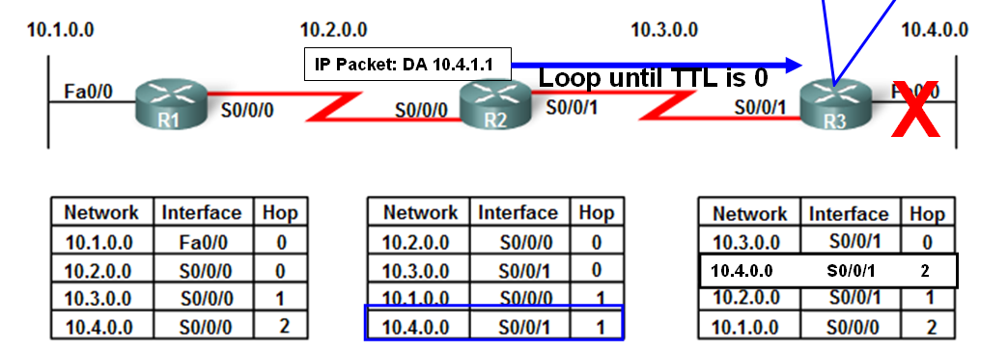
Implications of Routing Loops
I mistakenly believe I have a route to 10.4.0.0.
S0/0/1
Mechanisms available to eliminate routing loops:
  Defining a maximum metric to prevent count to infinity
  Hold-down timers
  Split horizon
  Route poisoning or poison reverse
  Triggered updates (covered previously)
Notes:
There are a number of mechanisms available to eliminate routing loops, primarily with distance vector routing protocols.
These mechanisms include
Defining a maximum metric to prevent count to infinity
Hold-down timers
Split horizon
Route poisoning or poison reverse
Triggered updates (covered previously)

Slide 39
Count-to-Infinity Condition
Periodic Update 10.4.0.0 3 hops thru me
Periodic Update 10.4.0.0 5 hops thru me
X
Periodic Update 10.4.0.0 2 hops thru me
Periodic Update 10.4.0.0 4 hops thru me
10.4.0.0 S0/0/1 2
4
3
S0/0/1
Count to infinity is a condition that exists when inaccurate routing updates increase the metric value to “infinity” for a network that is no longer reachable.
Each protocol defines infinity at a different value.
Notes:
Count to infinity is a condition that exists when inaccurate routing updates increase the metric value to “infinity” for a network that is no longer reachable.
Each protocol defines infinity at a different value.

Slide 40
Count-to-Infinity Condition
Periodic Update 10.4.0.0 13 hops thru me
Periodic Update 10.4.0.0 15 hops thru me
Periodic Update 10.4.0.0 16 hops thru me
Periodic Update 10.4.0.0 12 hops thru me
Periodic Update 10.4.0.0 14 hops thru me
X
Periodic Update 10.4.0.0 16 hops thru me
10.4.0.0 S0/0/1 10
12
14
16
12
S0/0/1
13
16 means “network unreachable” in RIP
15
16 means “network unreachable” in RIP
16
This count continues indefinitely, each router thinking the other router has a route to 10.4.0.0.
To eventually stop the incrementing of the metric, “infinity” is defined by setting a maximum metric value.
RIP defines infinity as 16 hops — an “unreachable” metric.
When the routers “count to infinity,” they mark the route as unreachable.
Notes:
This count continues indefinitely, each router thinking the other router has a route to 10.4.0.0.

Slide 41

Preventing Routing Loops with Hold-Down Timers
A routing loop could also be created by a periodic update that is sent by the routers during the instability.
Hold-down timers:
  Prevent routing loops from being created by these conditions.
Notes:
A routing loop could also be created by a periodic update that is sent by the routers during the instability.
Hold-down timers:
Prevent routing loops from being created by these conditions.
Help prevent the count-to-infinity condition.
Used to prevent regular update messages from inappropriately reinstating a route that might have gone bad.
Instruct routers to hold any changes that might affect routes for a specified period of time.
If a route is identified as down or possibly down, any other information for that route containing the same status, or worse, is ignored for a predetermined amount of time (the hold-down period).
This means that routers will leave a route marked as unreachable in that state for a period of time that is long enough for updates to propagate the routing tables with the most current information.

Slide 42
Preventing Routing Loops with Hold-Down Timers
Update timer not yet expired
X
Triggered Update
S0/0/1
Network 10.4.0.0 attached to R3 goes down.
R3 sends a triggered update.
Notes:
Network 10.4.0.0 attached to R3 goes down.
R3 sends a triggered update.

Slide 43
Preventing Routing Loops with Hold-Down Timers
X
Triggered Update
S0/0/1
Possibly down - Start Hold-down Timer
R2 receives the update from R3 indicating that network 10.4.0.0 is now no longer accessible.
R2 marks the network as possibly down and starts the hold-down timer.
Notes:
R2 receives the update from R3 indicating that network 10.4.0.0 is now no longer accessible.
R3 marks the network as possibly down and starts the hold-down timer.

Slide 44
Preventing Routing Loops with Hold-Down Timers
X
Triggered Update
S0/0/1
Possibly down - Start Hold-down Timer
Update with better metric
If an update with a better metric for that network is received from any neighboring router during the hold-down period, R2 will reinstate the network and the hold-down timer will be removed.
Note: In this example their can’t be a better metric than 1 hop.
Notes:
If an update with a better metric for that network is received from any neighboring router during the hold-down period, R2 will reinstate the network and the hold-down timer will be removed.
Note: In this example their can’t be a better metric than 1 hop.

Slide 45
Preventing Routing Loops with Hold-Down Timers
X
Update with worse metric: 10.4.0.0 3 hops
S0/0/1
Possibly down - Start Hold-down Timer
Same or worse metric - Still possibly down - Keep Hold-down Timer going
If an update from any other neighbor is received during the hold-down period with the same or worse metric for that network, that update is ignored.
Thus, more time is allowed for the information about the change to be propagated.
Notes:
If an update from any other neighbor is received during the hold-down period with the same or worse metric for that network, that update is ignored.
Thus, more time is allowed for the information about the change to be propagated.

Slide 46

Preventing Routing Loops with Hold-Down Timers
X
IP Packet: DA 10.4.1.1
S0/0/1
Possibly down
Possibly down
R1 and R2 still forward packets to 10.4.0.0, even though it is marked as possibly down.
This allows the router to overcome any issues associated with intermittent connectivity.
If the destination network is truly unavailable and the packets are forwarded, black-hole routing is created and lasts until the hold-down timer expires.
Notes:
R1 and R2 still forward packets to 10.4.0.0, even though it is marked as possibly down.
This allows the router to overcome any issues associated with intermittent connectivity.
If the destination network is truly unavailable and the packets are forwarded, black-hole routing is created and lasts until the hold-down timer expires.

Slide 47
Preventing Routing Loops with Hold-Down Timers
Expires
Expires
X
S0/0/1
Possibly down
Possibly down
When the hold-down timers expire on R1 and R2, 10.4.0.0 is removed from the routing table.
No traffic to 10.4.0.0 will be routed – packets dropped by each router.
Notes:
When the hold-down timers expire on R1 and R2, 10.4.0.0 is removed from the routing table.
No traffic to 10.4.0.0 will be routed – packets dropped by each router.

Slide 48
Preventing Routing Loops with the Split Horizon Rule
S0/0/1
Split horizon rule says that a router should not advertise a network through the interface from which the update came.
  Helps prevent routing loops caused by slow convergence.
What network(s) will R1 NOT include in its routing updates to R2?
  10.3.0.0 and 10.4.0.0
What network(s) will R2 NOT include in its routing updates R1? R3?
  R1: 10.1.0.0 R3: 10.4.0.0
What network(s) will R3 NOT include in its routing updates R2?
  10.1.0.0 and 10.2.0.0
Notes:
Split horizon rule says that a router should not advertise a network through the interface from which the update came.
Another method used to prevent routing loops caused by slow convergence of a distance vector routing protocol.

Slide 49
Preventing Routing Loops with the Split Horizon Rule
Periodic Update: 10.4.0.0
X
Periodic Update: 10.4.0.0
X
Periodic Update: 10.4.0.0
S0/0/1
1. R3 advertises the 10.4.0.0 network to R2.
2. R2 receives the information and updates its routing table.
3. R2 then advertises the 10.4.0.0 network to R1 out S0/0/0.
  R2 does not advertise 10.4.0.0 to R3 out S0/0/1, because the route originated from that interface.
4. R1 receives the information and updates its routing table.
5. Because of split horizon, R1 also does not advertise the information about network 10.4.0.0 back to R2.
Notes:
1. R3 advertises the 10.4.0.0 network to R2.
2. R2 receives the information and updates its routing table.
3. R2 then advertises the 10.4.0.0 network to R1 out S0/0/0.
R2 does not advertise 10.4.0.0 to R3 out S0/0/1, because the route originated from that interface.
4. R1 receives the information and updates its routing table.
5. Because of split horizon, R1 also does not advertise the information about network 10.4.0.0 back to R2.

Slide 50
Preventing Routing Loops with the Split Horizon Rule
S0/0/1
What networks does R1 advertise to R2?
  R1 advertises network 10.1.0.0 to R2.
What networks does R2 advertise to R1?
  R2 advertises networks 10.3.0.0 and 10.4.0.0 to R1.
What networks does R2 advertise to R3?
  R2 advertises networks 10.1.0.0 and 10.2.0.0 to R3.
What networks does R3 advertise to R2?
  R3 advertises network 10.4.0.0 to R2.
Notice that each router increments the hop count before sending the update.
Split horizon can be disabled by an administrator to achieve the proper routing under certain conditions.
Notes:
Results:
R1 advertises network 10.1.0.0 to R2.
R2 advertises networks 10.3.0.0 and 10.4.0.0 to R1.
R2 advertises networks 10.1.0.0 and 10.2.0.0 to R3.
R3 advertises network 10.4.0.0 to R2.
Notice that each router increments the hop count before sending the update.
Split horizon can be disabled by an administrator to achieve the proper routing under certain conditions.

Slide 51
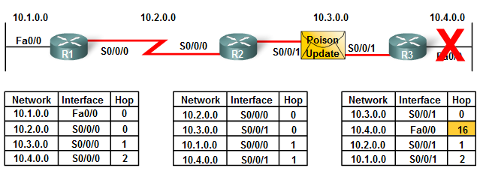
Route Poisoning
Route poisoning is used to mark the route as unreachable in a routing update that is sent to other routers.
  Unreachable is interpreted as a metric that is set to the maximum.
  For RIP, a poisoned route has a metric of 16.
Route poisoning speeds the convergence process.
Notes:
Route poisoning is used to mark the route as unreachable in a routing update that is sent to other routers.
Unreachable is interpreted as a metric that is set to the maximum.
For RIP, a poisoned route has a metric of 16.
Route poisoning speeds the convergence process because the information about 10.4.0.0 spreads through the network more quickly than waiting for the hop count to reach “infinity.”

Slide 52
Split Horizon with Poison Reverse
Periodic Update: 10.4.0.0 = 16
S0/0/1
Split horizon with poison reverse
The concept of split horizon with poison reverse is that explicitly telling a router to ignore a route is better than not telling it about the route in the first place.
Notes:
Split horizon with poison reverse
Poison reverse can be combined with the split horizon technique.
The rule for split horizon with poison reverse states that when sending updates out a specific interface, you should designate any networks that were learned on that interface as unreachable.
The concept of split horizon with poison reverse is that explicitly telling a router to ignore a route is better than not telling it about the route in the first place.

Slide 53
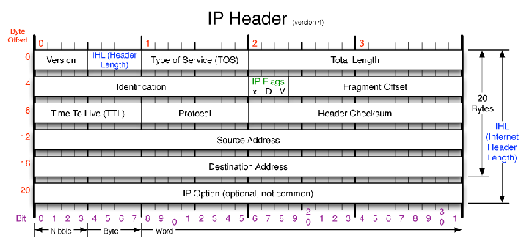
Preventing Routing Loops with IP and TTL
The Time to Live (TTL) is an 8-bit field in the IP header that limits the number of hops a packet can traverse through the network before it is discarded.
The TTL is decreased by 1 by every router on the route to its destination.
If the TTL field reaches 0 before the packet arrives at its destination, the packet is discarded and the router sends an Internet Control Message Protocol (ICMP) error message back to the source of the IP packet.
Notes:
The Time to Live (TTL) is an 8-bit field in the IP header that limits the number of hops a packet can traverse through the network before it is discarded.
The purpose of the TTL field is to avoid a situation in which an undeliverable packet keeps circulating on the network endlessly.
With TTL, the 8-bit field is set with a value by the source device of the packet.
The TTL is decreased by 1 by every router on the route to its destination.
If the TTL field reaches 0 before the packet arrives at its destination, the packet is discarded and the router sends an Internet Control Message Protocol (ICMP) error message back to the source of the IP packet.

Slide 54
Preventing Routing Loops with IP and TTL
IP Packet: DA 10.4.1.1
Loop until TTL is 0
X
Periodic Update 10.4.0.0 2 hops thru me
10.4.0.0 S0/0/1 2
S0/0/1
Situation where the routing tables do not have accurate information about the downed 10.4.0.0 network.
Even in the case of this routing loop, packets will not loop endlessly in the network.
Eventually the TTL value will be decreased to 0 and the packet will be discarded by the router.
Notes:
Situation where the routing tables do not have accurate information about the downed 10.4.0.0 network.
Even in the case of this routing loop, packets will not loop endlessly in the network.
Eventually the TTL value will be decreased to 0 and the packet will be discarded by the router.

Slide 55
Distance Vector Routing Protocols Today
RIP
EIGRP

Slide 56
Distance Vector Routing Protocols Today
Although link-state routing protocols have several advantages over distance vector routing protocols, distance vector routing protocols are still in use today.
Link-state routing protocols will be discussed later.
Notes:
Although link-state routing protocols have several advantages over distance vector routing protocols, distance vector routing protocols are still in use today.
Link-state routing protocols will be discussed later.

Slide 57
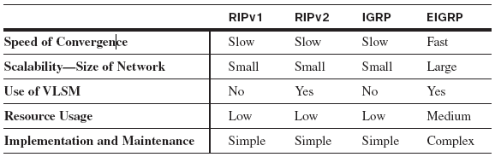
RIP and EIGRP
For distance vector routing protocols, there really are only two choices: RIP or EIGRP.
The decision about which routing protocol to use in a given situation is influenced by a number of factors, including
  Size of the network
  Compatibility between models of routers
  Administrative knowledge required
Notes:
For distance vector routing protocols, there really are only two choices: RIP or EIGRP.
The decision about which routing protocol to use in a given situation is influenced by a number of factors, including
Size of the network
Compatibility between models of routers
Administrative knowledge required
RIP
Both RIPv1 and RIPv2 have a route metric that is based only on hop count and that is limited to 15 hops.
Features of RIP include
Supports split horizon and split horizon with poison reverse to prevents loops.
Periodic updates and triggered updates
Is capable of load-balancing up to six equal-cost paths.
The default is four equal-cost paths.
RIPv2 introduced the following improvements to RIPv1 (later):
Includes the subnet mask in the routing updates, making it a classless routing protocol
Has an authentication mechanism to secure routing table updates
Supports variable-length subnet mask (VLSM)
Uses multicast addresses instead of broadcast
Supports manual route summarization
EIGRP
EIGRP is a proprietary protocol developed by Cisco and runs only on Cisco routers.
EIGRP features include (later):
Triggered updates (EIGRP has no periodic updates).
Use of a topology table to maintain all the routes received from neighbors (not only the best paths).
Establishment of adjacencies with neighboring routers using the EIGRP Hello protocol.
Support for VLSM and manual route summarization.
Advantages of EIGRP are as follows:
Although routes are propagated in a distance vector manner, the metric is based on minimum bandwidth and cumulative delay of the path.
Fast convergence: Diffusing Update Algorithm (DUAL) route calculation.
DUAL allows the insertion of backup routes into the EIGRP topology table, which are used immediately in case the primary route fails.
Bounded updates mean that EIGRP uses less bandwidth.
EIGRP supports multiple network layer protocols through Protocol Dependent Modules, which include support for IP, IPX, and AppleTalk.

Slide 58
RIPv1: First Look

Slide 59
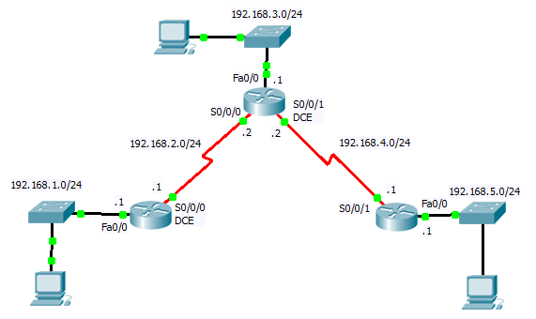
RIPv1: First Look
Download Packet Tracer Topology: cis82-RIPv1-A-student.pkt

Slide 60
Specifying Networks
Only directly connected classful network addresses!
R1(config)# router rip
R1(config-router)# network directly-connected-classful-network-address
R1(config-router)# ...
R2(config)# router rip
R2(config-router)# network directly-connected-classful-network-address
R2(config-router)# ...
R3(config)# router rip
R3(config-router)# network directly-connected-classful-network-address
R3(config-router)# ...
Use the network command for each directly connected network.

Slide 61
Specifying Networks
Only directly connected classful network addresses!
R1(config)# router rip
R1(config-router)# network 192.168.1.0
R1(config-router)# network 192.168.2.0
R2(config)# router rip
R2(config-router)# network 192.168.2.0
R2(config-router)# network 192.168.3.0
R2(config-router)# network 192.168.4.0
R3(config)# router rip
R3(config-router)# network 192.168.4.0
R3(config-router)# network 192.168.5.0
Verify with the commands: show ip route show ip protocols
If you enter a subnet or host IP address, IOS automatically converts it to a classful network address.
For example, if you enter the command network 192.168.1.32, the router will convert it to network 192.168.1.0.

Slide 62
Verifying RIP: show ip route Command
R1# show ip route
Codes: C - connected, S - static, I - IGRP, R - RIP, M - mobile,
<output omitted>
Gateway of last resort is not set
R 192.168.4.0/24 [120/1] via 192.168.2.2, 00:00:02, Serial0/0/0
R 192.168.5.0/24 [120/2] via 192.168.2.2, 00:00:02, Serial0/0/0
C 192.168.1.0/24 is directly connected, FastEthernet0/0
C 192.168.2.0/24 is directly connected, Serial0/0/0
R 192.168.3.0/24 [120/1] via 192.168.2.2, 00:00:02, Serial0/0/0
An R in the output indicates RIP routes.
Because this command displays the entire routing table, including directly connected and static routes, it is normally the first command used to check for convergence.
Routes might not immediately appear when you execute the command because networks take some time to converge.

Slide 63
Verifying RIP: show ip route Command
R2# show ip route
Codes: C - connected, S - static, I - IGRP, R - RIP, M - mobile,
<output omitted>
Gateway of last resort is not set
C 192.168.4.0/24 is directly connected, Serial0/0/1
R 192.168.5.0/24 [120/1] via 192.168.4.1, 00:00:12, Serial0/0/1
R 192.168.1.0/24 [120/1] via 192.168.2.1, 00:00:24, Serial0/0/0
C 192.168.2.0/24 is directly connected, Serial0/0/0
C 192.168.3.0/24 is directly connected, FastEthernet0/0

Slide 64
Verifying RIP: show ip route Command
R3# show ip route
Codes: C - connected, S - static, I - IGRP, R - RIP, M - mobile,
<output omitted>
Gateway of last resort is not set
C 192.168.4.0/24 is directly connected, Serial0/0/1
C 192.168.5.0/24 is directly connected, FastEthernet0/0
R 192.168.1.0/24 [120/2] via 192.168.4.2, 00:00:08, Serial0/0/1
R 192.168.2.0/24 [120/1] via 192.168.4.2, 00:00:08, Serial0/0/1
R 192.168.3.0/24 [120/1] via 192.168.4.2, 00:00:08, Serial0/0/1

